Slide 1
COPYRIGHT ONLINE REGULATION
French approach

Slide 2
About HADOPI
The high authority for the distribution and protection of copyright works on the Internet (HADOPI)
An independant public agency created by the law dated 22 October 2009
Missions essentialy are :
the protection of rights on peer to peer networks
the encouragement of the development of legal online offers as an alternative to piracy (including the regulation of technical protection measures)
the obervation of legal and illegal usages of works of authorship on Internet

Slide 3
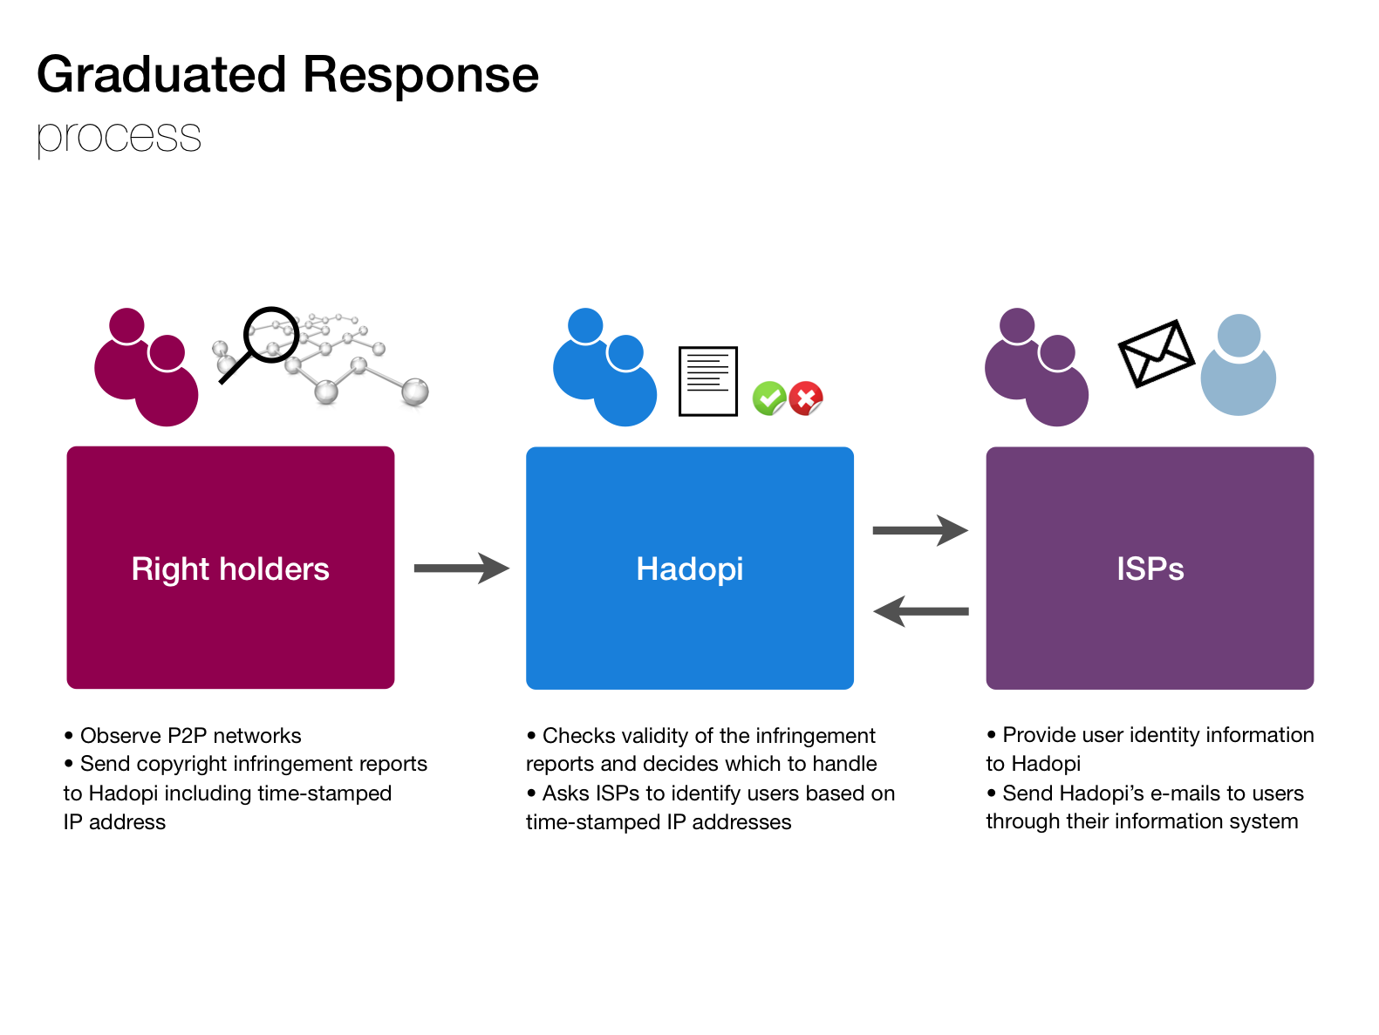
COPYRIGHT PROTECTION 1/3
THE GRADUATED RESPONSE

Slide 4
COPYRIGHT PROTECTION 2/3
KEY NUMBERS OF THE GRADUATED RESPONSE
Numbers of 1st recommendations
1 767 847
Numbers of 2nd recommendation
159 653
Numbers of deliberations
559

Slide 5
COPYRIGHT PROTECTION 3/3
What evolutions in the future ? - Lescure report
Lescure report dated May 13th 2013 recommends :
An evolution of the graduated response
The graduated response should be preserved but should be « renovated » :
Still an educational scheme
Abrogation of suspension of Internet access
Administrative and lowered penalty
And, also, a co-regulation scheme in order to tackle unlawful streaming and direct downloading

Slide 6
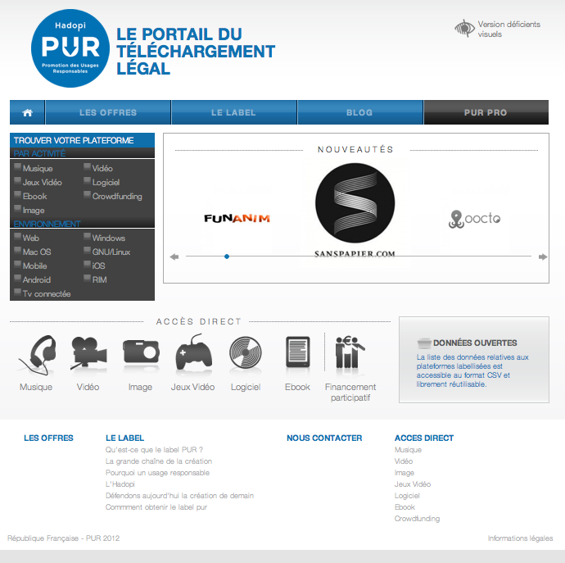
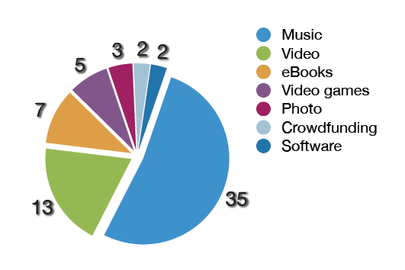
PROMOTING ONLINE OFFERS 1/2
Label to indentify legal offers
Observation of legal and illegal usages :
Regulation of technical protection measures
8

Slide 7
PROMOTING ONLINE OFFERS 2/2
What evolutions in the future ? - Lescure report
Call for a stronger and more extensive regulation of technical protection measure and for the preservation of a specific and permanent observation mission.
Call for a broader “regulation of the digital content offer” (new tools for the regulator) ; implementation of the missions within a comprehensive and coherent framework, entrusted to a single entity (CSA).
8

Slide 8
Grazie mille
hadopi.fr
pur.fr

